Slide 1
DS Sept 2022 Batch
Module 8: Statistics Basics
Topics
Statistics Terminologies
Descriptive Statistics : Central Tendency
Variance, Standard deviation
Measures of Position
Covariance
Pearson's and Spearman Correlation Coefficients
Correlation vs. Causation
Different types of Plots for Continuous, Categorical variable

Slide 2
Statistics Terminologies

Slide 3
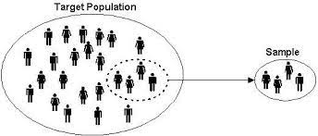
Population Vs Sample
Statistics
The science of collecting, organizing, presenting, analyzing, and interpreting data to assist in making more effective decisions.
Population
Generally, population refers to the people who live in a particular area at a specific time.
But in statistics, population refers to data on your study of interest. It can be a group of individuals, objects, events, organizations, etc.
Sample
A sample is defined as a smaller and more manageable representation of a larger group.
A subset of a larger population that contains characteristics of that population. A sample is used in statistical testing when the population size is too large for all members or observations to be included in the test.

Slide 4
Parameter vs Statistic
Parameter
Parameters are numbers that describe the properties of entire populations.
Statistic
Statistics are numbers that describe the properties of samples.
Example :
The average income for the India is a population parameter.
The average income for a sample drawn from the India is a sample statistic.

Slide 5
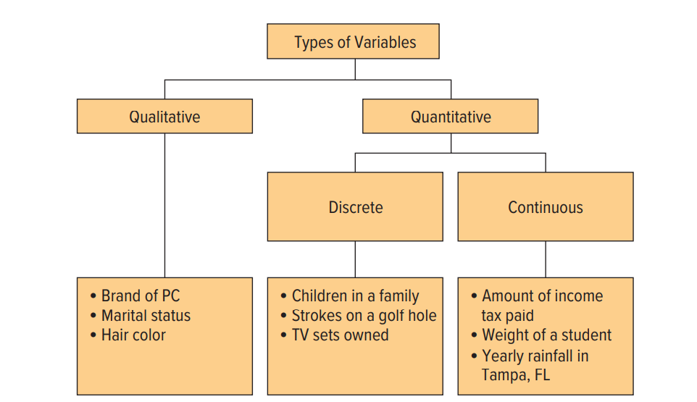
Types of Variables

Slide 6
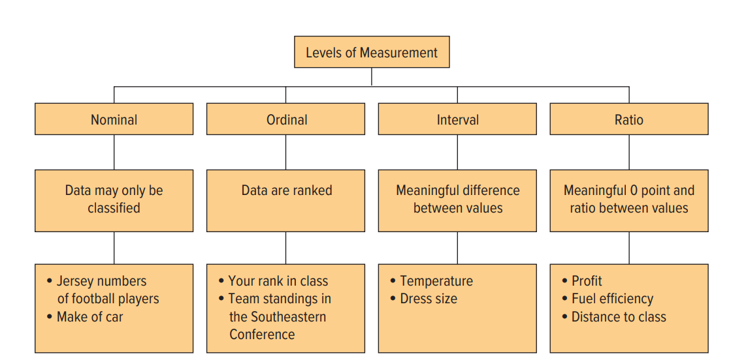
Levels of Measurement

Slide 7
Descriptive Statistics : Central Tendency

Slide 8
Central Tendency
Measures of Central Tendency
Central tendency is defined as “the statistical measure that identifies a single value as representative of an entire distribution. It represents the single value of the entire population or a dataset.
We will consider five Measures of Central Tendency
the arithmetic mean
the median
the mode
the weighted mean
the geometric mean.
Measures of Central Tendency
Central tendency is defined as “the statistical measure that identifies a single value as representative of an entire distribution. It represents the single value of the entire population or a dataset.
We will consider five Measures of Central Tendency
the arithmetic mean
the median
the mode
the weighted mean
the geometric mean.

Slide 9
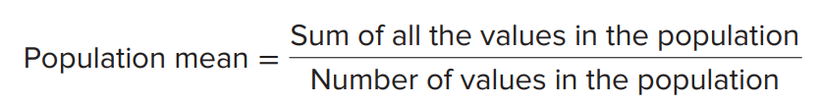

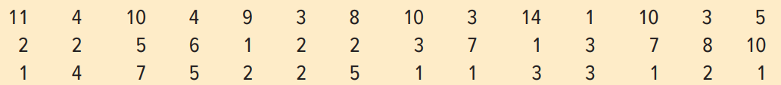
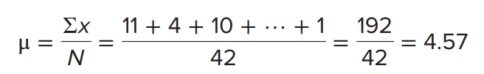
Arithmetic Mean
Population Mean
the population mean is the sum of all the values in the population divided by the number of values in the population. To find the population mean, we use the following formula.
It is denoted by μ
Example
Listed below are the distances between exits (in miles).

Slide 10
Arithmetic Mean
Properties of Arithmetic mean:
The arithmetic mean is a widely used measure. It has several important properties:
To compute a mean, the data must be measured at the interval or ratio level.
The mean is unique. That is, there is only one mean in a set of data. we will discover a measure of central tendency that may have more than one value.
Disadvantage of Arithmetic mean
One of the major drawbacks of arithmetic mean is that it is changed by extreme values in the data set.
It is not an appropriate average for highly skewed distributions.
It cannot be computed accurately if any item is missing.

Slide 11
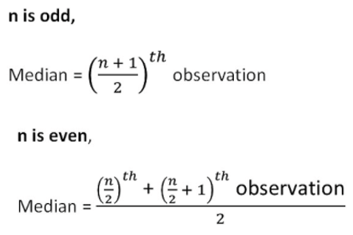
Median
Median
When our data contains one or two very large or very small values, the arithmetic mean may not be representative. The center for such data is better described by a measure of location called the median.
The midpoint of the values after they have been ordered from the minimum to the maximum values.
Formula for median
Where n is total number of data points in our sample.

Slide 12

Median
Example 1 (Odd numbers):
21,32,65,40,30,90,26
Ordered list : 21,26,30,32,40,65,90
n = 7
Median
= ${(\frac{7+1}{2}\text{)}}^{th}$ Observation
= 4th observation = 32
Example 1 (Even numbers):
10,9,7,12,8,11
Ordered list : 7,8,9,10,11,12
n = 6
Median
=$\frac{{(\frac{6}{2}\text{)}}^{th} observation+{(\frac{6}{2}+1\text{)}}^{th}observation}{2}$
= $\frac{3^{rd} observation+4^{th} observation}{2}$
= $\frac{9+10}{2}$
= 9.5

Slide 13
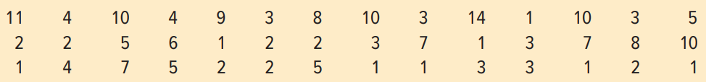
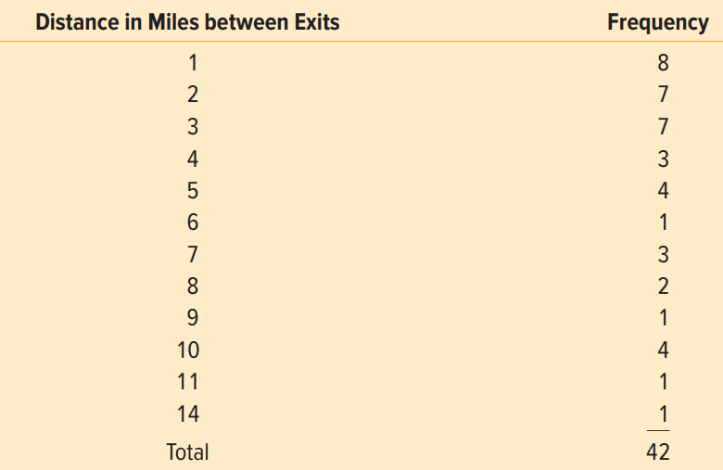
Mode
In a dataset mode is the value of the observation that appears most frequently.
The value of the observation that appears most frequently.
Example :
The frequency table for above data is shown below
As we can see that value 1 is occurring most number of time (8 times) the mode is 1.
Note* : A dataset can consist of more than 1 mode which is called multimodal dataset.

Slide 14
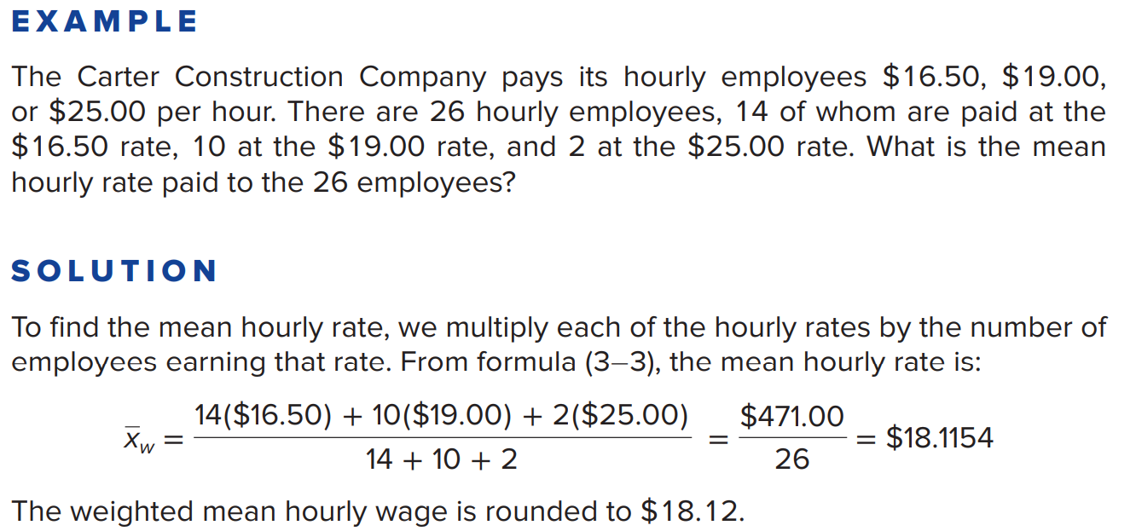
Weighted mean
The weighted mean is a convenient way to compute the arithmetic mean when there are several observations of the same value.
the weighted mean of a set of numbers designated x1, x2, x3, . . . , xn with the corresponding weights w1, w2, w3, . . . , wn is computed by:

Slide 15
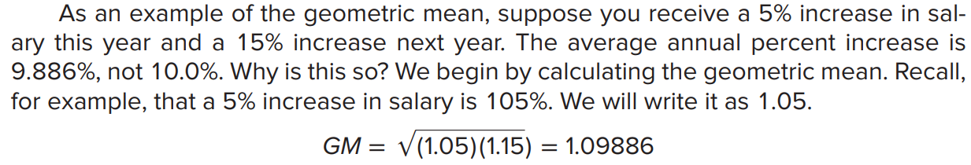
Geometric mean
The geometric mean is useful in finding the average change of percentages, ratios, indexes, or growth rates over time.
The geometric mean of a set of n positive numbers is defined as the nth root of the product of n values. The formula for the geometric mean is written:

Slide 16
Measures of Dispersion

Slide 17
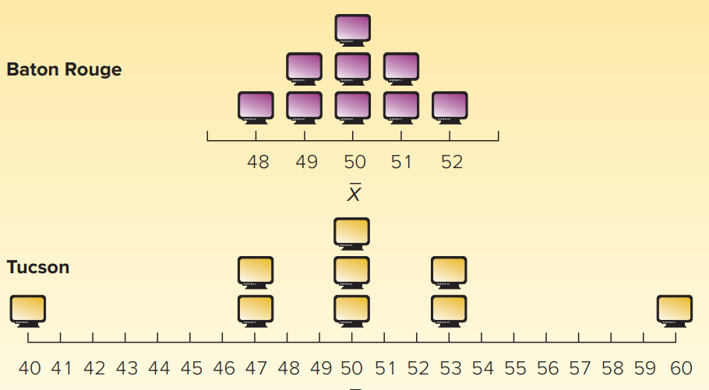
Measure of Dispersion
Why should we study Measure of Dispersion?
A measure of location, such as the mean, median, or mode, only describes the center of the data.
It is valuable from that standpoint, but it does not tell us anything about the spread of the data.

Slide 18
Range
The simplest measure of dispersion is the range.
It is the difference between the maximum and minimum values in a data set.
Example :
In the above dataset
Minimum = 1
Maximum = 14
Therefore
Range = 14-1 = 13

Slide 19
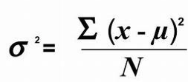
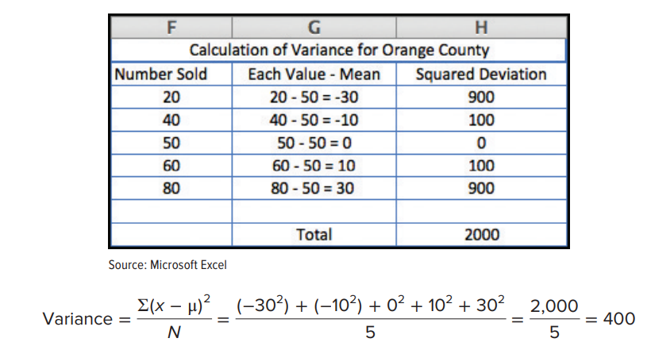
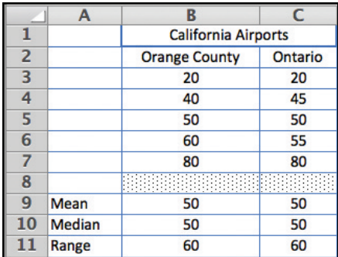
Variance
A limitation of the range is that it is based on only two values, the maximum and the minimum; it does not take into consideration all of the values. The variance does.
It measures the mean amount by which the values in a population, or sample, vary from their mean.
Formula for variance is
Example :

Slide 20

Population Standard deviation
When we compute the variance, it is important to understand the unit of measure and what happens when the differences in the numerator are squared.
Units of standard deviation is same as units of our dataset.
Standard deviation is squared root of variance
Formula:

Slide 21

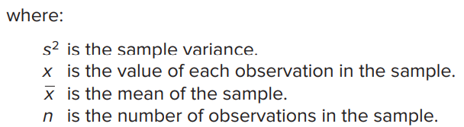

Sample Variance and Sample Standard deviation
Sample Variance
The formula for the sample variance is:
Sample Standard deviation
Sample standard deviation is square root of sample variance and it is denoted by s.
Why n-1 instead of n?
Although the use of n is logical since $\overline{x}$ is used to estimate μ, it tends to underestimate the population variance, $σ^{2}$.
The use of (n − 1) in the denominator provides the appropriate correction for this tendency.
Because the primary use of sample statistics like s2 is to estimate population parameters like σ2, (n − 1) is used instead of n in defining the sample variance

Slide 22
Measures of Position

Slide 23
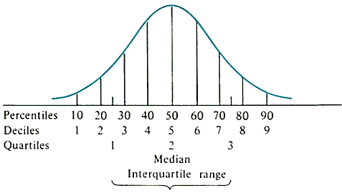
Quartiles, Deciles and Percentiles
Measures of position
The standard deviation is the most widely used measure of dispersion. However, there are other ways of describing the variation or spread in a set of data.
One method is to determine the location of values that divide a set of observations into equal parts.
These measures include quartiles, deciles, and percentiles.
Quartiles
Quartiles divide a set of observations into four equal parts.
The first quartile, usually labelled Q1, is the value below which 25% of the observations occur
The third quartile, usually labelled Q3, is the value below which 75% of the observations occur.
The second quartile, usually labelled as Q2 or Median is the value below which 50% and above which 50% of the observations occur.
Deciles
Deciles divide a set of observations into 10 equal parts
Percentiles
Percentiles divide a set of observations into 100 equal parts

Slide 24
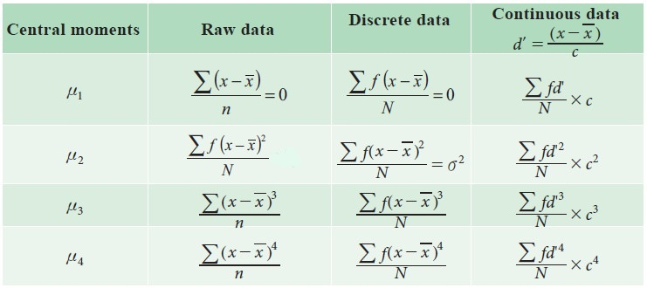
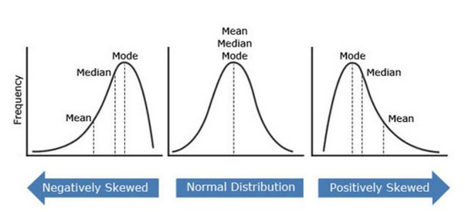
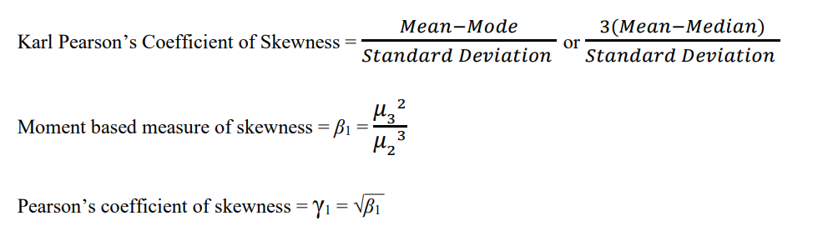
Skewness
Skewness is a measure of the asymmetry of a distribution.
A distribution is asymmetrical when its left and right side are not mirror images.
A distribution can have right (or positive), left (or negative), or zero skewness.
Value | Interpretation
-3 to 0 | Negative Skewness
0 | No Skewness
0 to 3 | Positive Skewness

Slide 25
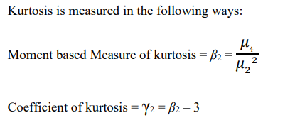
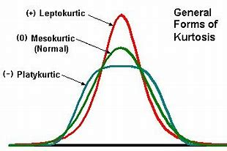
Kurtosis
Kurtosis refers to the degree of peak of a frequency curve.
It tells how tall and sharp the central peak is, relative to a standard bell curve of a distribution.
Formula for Kurtosis
Kurtosis can be described in the following ways:
• Platykurtic– When the kurtosis < 0, the frequencies throughout the curve are closer to be equal (i.e., the curve is more flat and wide)
• Leptokurtic– When the kurtosis > 0, there are high frequencies in only a small part of the curve (i.e., the curve is more peaked)
• Mesokurtic- When the kurtosis = 0 To show the peakedness of a distribution
• Platykurtic: flat and spread out
• Leptokurtic: high and thin
• Mesokurtic: normal in shape

Slide 26
Covariance

Slide 27
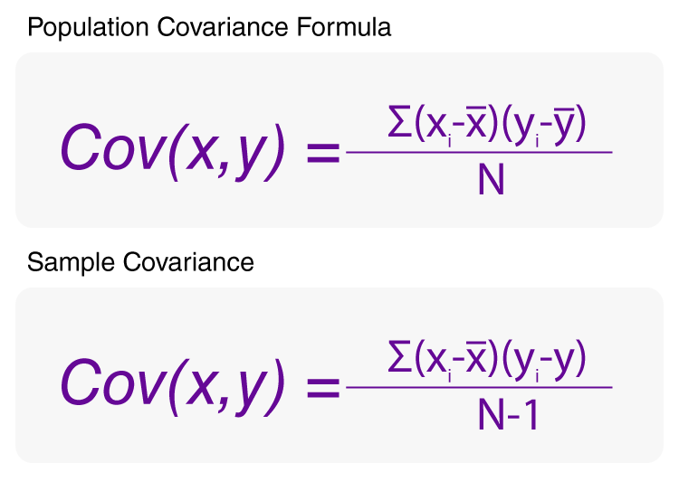
Covariance
Covariance measures the direction of the relationship between two variables.
A positive covariance means that both variables tend to be high or low at the same time.
A negative covariance means that when one variable is high, the other tends to be low.
A covariance of zero indicates that there is no clear directional relationship between the variables being measured.
Note :The covariance can range from negative infinity to positive infinity.Thus, the value for a perfect linear relationship depends on the data.

Slide 28
Correlation

Slide 29

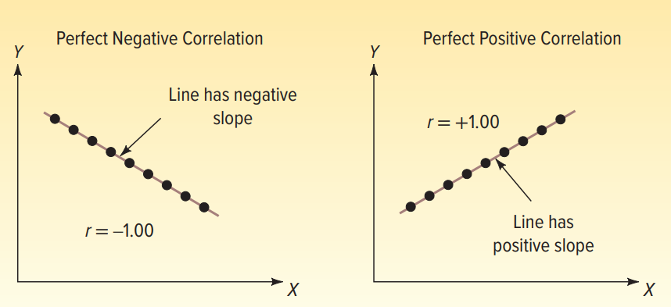
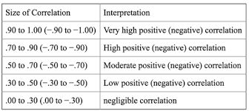
Pearson’s Correlation
Pearson’s correlation coefficient can be calculated to measure the direction and strength of the relationship between two variables.
The correlation coefficient is computed as:
The sample correlation coefficient, specified by r, ranges from −1.0 to +1.0.

Slide 30
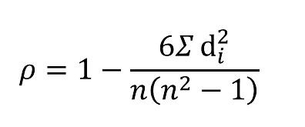
Spearman’s Rank Correlation
Spearman’s rank correlation measures the strength and direction of association between two ranked variables. It basically gives the measure of monotonicity of the relation between two variables.
The formula for Spearman’s rank coefficient is:
𝝆 = Spearman’s rank correlation coefficient
di = Difference between the two ranks of each observation
n = Number of observations
The Spearman Rank Correlation can take a value from +1 to -1 where,
A value of +1 means a perfect association of rank
A value of 0 means that there is no association between ranks
A value of -1 means a perfect negative association of rank

Slide 31
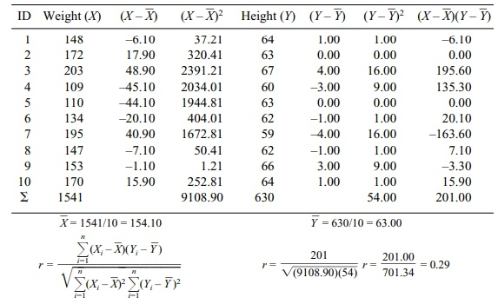
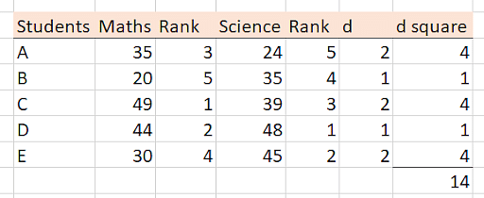
Example
Example : Pearson’s correlation Coefficient
Example : Spearman’s Rank Correlation
= 1 - (6 * 14) / 5(25 - 1)
= 0.3

Slide 32
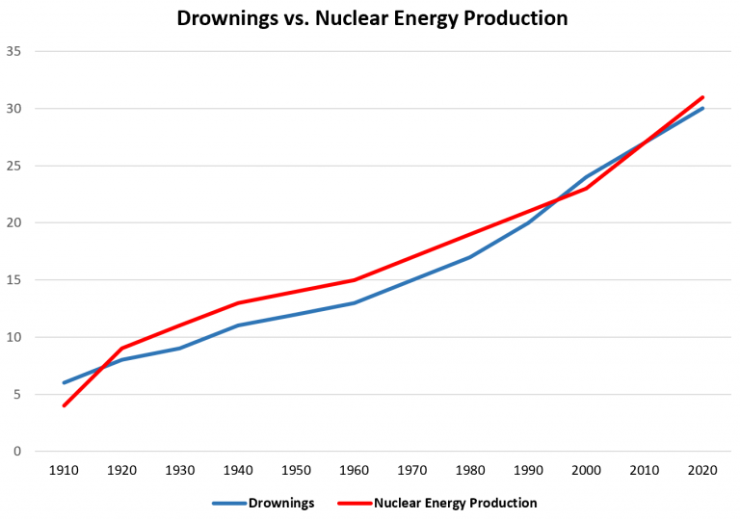
Correlation vs Causation
Correlation is a statistical measure (expressed as a number) that describes the size and direction of a relationship between two or more variables.
A correlation between variables, however, does not automatically mean that the change in one variable is the cause of the change in the values of the other variable. Causation indicates that one event is the result of the occurrence of the other event; i.e. there is a causal relationship between the two events.
This is also referred to as cause and effect.
Example :
Pool Drownings vs. Nuclear Energy Production
If we collect data for the total number of pool drownings each
year and the total amount of energy produced by nuclear power plants
each year, we would find that the two variables are highly correlated.
Note : While causation and correlation can exist at the same time, correlation does not imply causation.

Slide 33
Different Types of plots for Categorical Variables

Slide 34
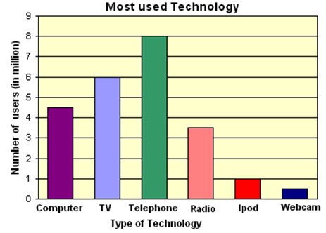
Plots for Categorical Variables
Bar Plot
A bar chart or bar graph is a chart or graph that presents categorical data with rectangular bars with heights or lengths proportional to the values that they represent.
The bars can be plotted vertically or horizontally.
Each categorical value claims one bar, and the length of each bar corresponds to the bar's value.
From the above Graph we can see that Telephone has most number of users followed by TV and Computer.
Hence Bar plot can be used to compare categorical variables on the basis of counts.

Slide 35
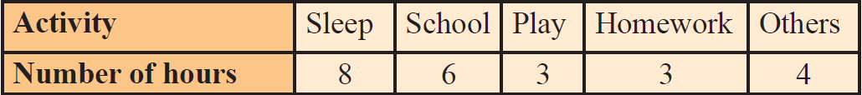
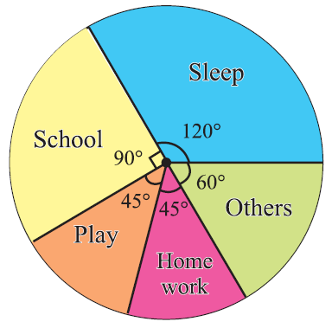
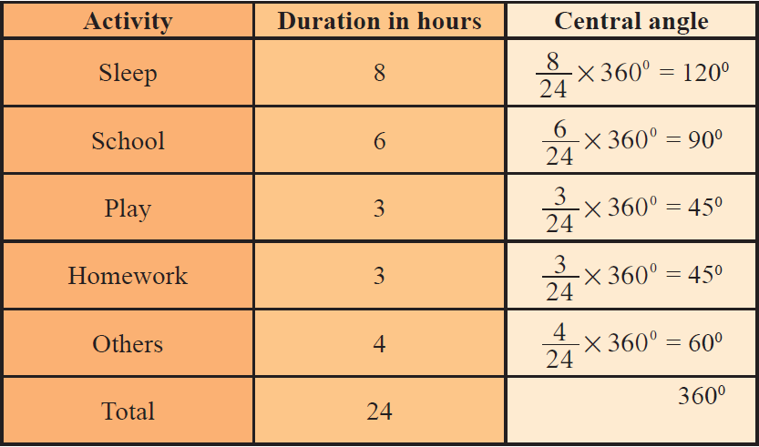
Pie Chart
Pie charts show the size of items (called wedge) in one data series, proportional to the sum of the items.
The data points in a pie chart are shown as a percentage of the whole pie.
The total angle of 360° at the center of the circle is divided according to the values of the components.
A pie chart is used to compare frequencies of categorical variables.
The central angle of a component is
= [Value of the component / Total value] ⋅ 360°
Example

Slide 36
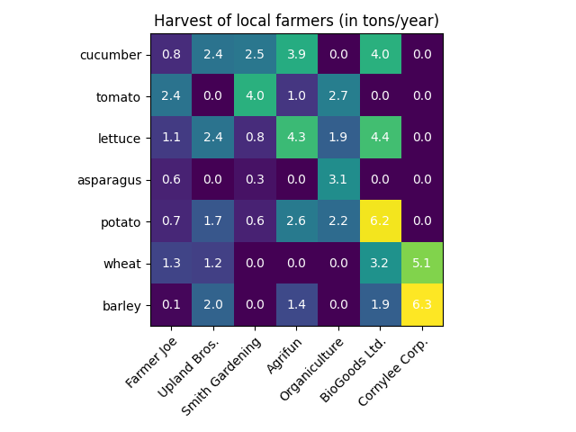
Heat Map
A heat map is a two-dimensional representation of data in which values are represented by colors. A simple heat map provides an immediate visual summary of information.
Heat map can be used to compare values of crosstabulation of categorical variables.
Example

Slide 37
Different Types of plots for Continuous Variables

Slide 38
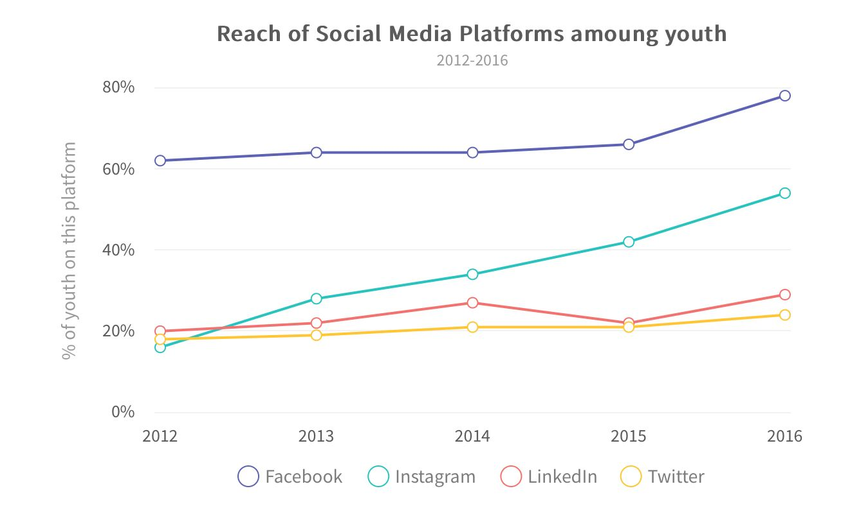
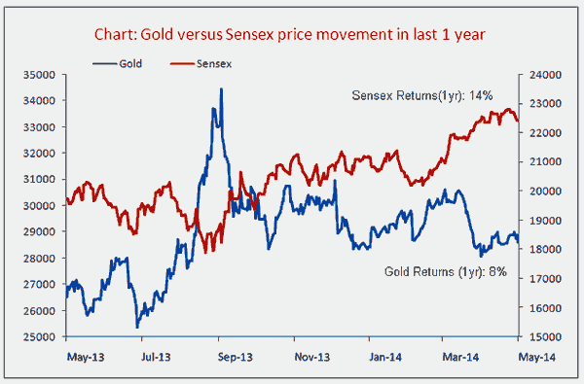
Plots for Continuous Variables
Line Plot
A line chart or line plot or line graph or curve chart is a type of chart which displays information as a series of data points called 'markers' connected by straight line segments.
Line Plots are widely used in time series to identify the pattern of the data.

Slide 39
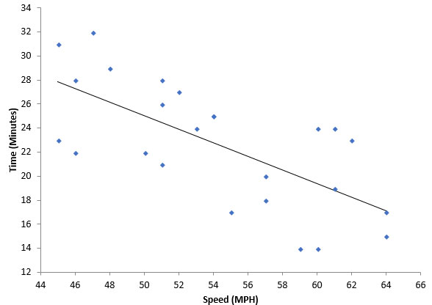
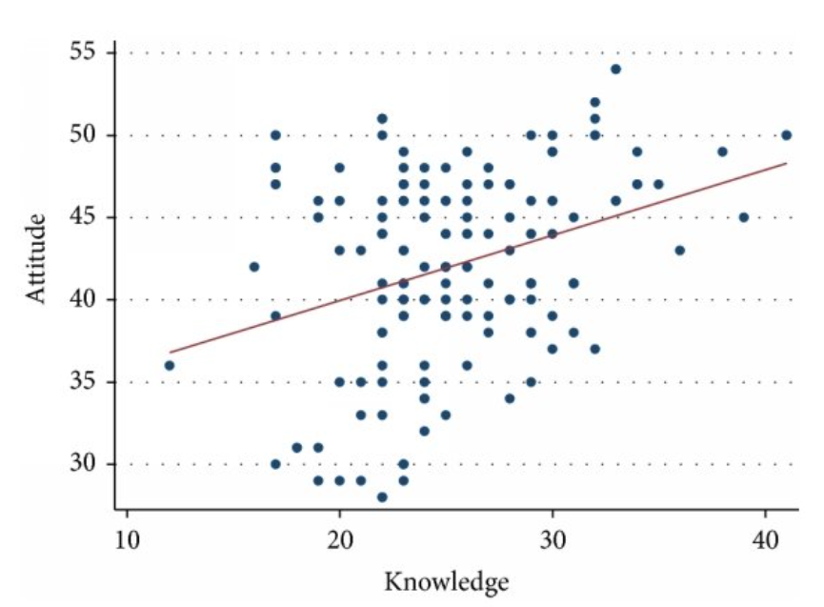
Scatter Plot
Scatter plots are the graphs that present the relationship between two variables in a data-set.
It represents data points on a two-dimensional plane or on a Cartesian system.
In scatter plot data points on a horizontal and a vertical axis in the attempt to show how much one variable is affected by another.
It is used in data analysis for checking correlation between two variables.

Slide 40
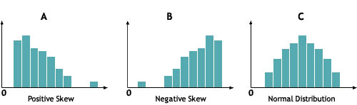
Histogram
A histogram is an accurate representation of the distribution of numerical data. It is a kind of bar graph.
Histogram is used when the data is numerical and You want to see the shape of the data’s distribution, specially when determining whether the output of a process is distributed approximately normally.
Each bin is plotted as a bar whose height corresponds to how many data points are in that bin. Bins are also sometimes called "intervals", "classes", or "buckets".

Slide 41
Density Plot
A density plot is a representation of the distribution of a numeric variable.
It uses a kernel density estimate to show the probability density function of the variable (see more).
It is a smoothed version of the histogram and is used in the same concept.
An advantage Density Plots have over Histograms is that they're better at determining the distribution shape because they're not affected by the number of bins used (each bar used in a typical histogram).

Slide 42
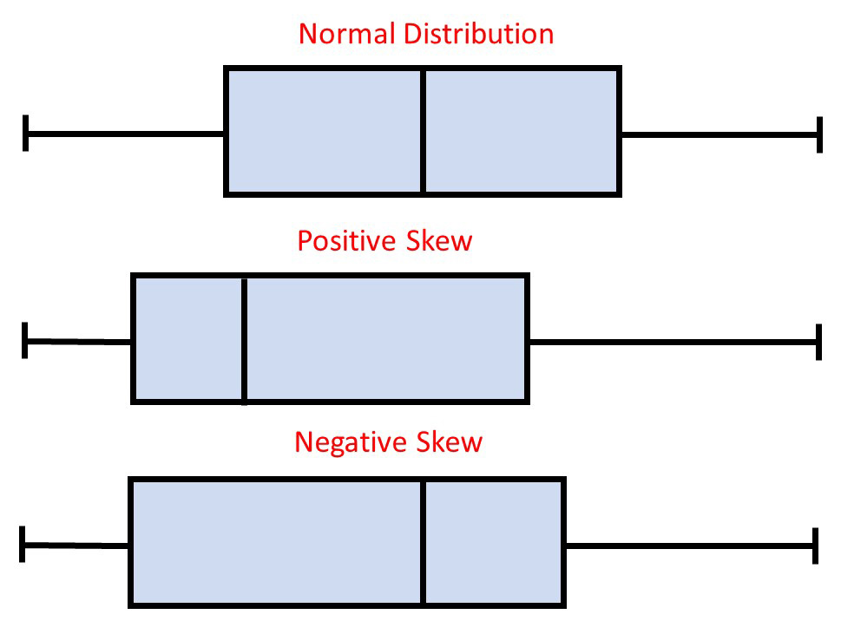
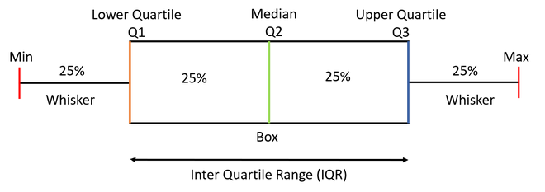
Box Plot
A box plot which is also known as a whisker plot displays a summary of a set of data containing the
minimum
first quartile (Q1)
Median (Q2)
third quartile (Q3)
Maximum
Above five are referred to as five number summary in statistics.
Histogram is also used to check the distribution of a numerical variable by partitioning the data into four equal parts.

Slide 43
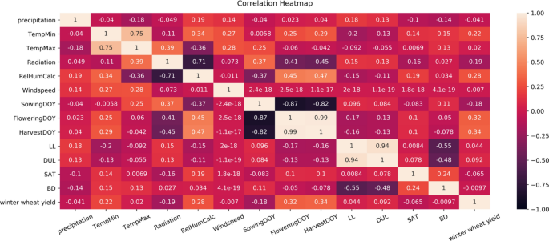
Heat Map
A heat map is a two-dimensional representation of data in which values are represented by colors.
A simple heat map provides an immediate visual summary of information.
It is widely used to check correlation between variables of our data.

Slide 44


